Slide 1

COFFEE TIME
Coffee Time
Manager: John Ekemini

Slide 2
Contents
What is on our menu?
Coffee
Non-Coffee
Breakfast
Display of the Coffee Menu
Display of the Non-Coffee Menu
Display of the Breakfast Menu
Sales for Each Month
Items sold in Each Department
Different Marketing Methods
Employees’ Information
References

Slide 3
Display of the Coffee Menu
Espresso
Iced Coffee
Latte
Americano
Cappuccino
Decaf

Slide 4
Display of the Non-Coffee Menu
Green Tea
Vanilla Milkshake
Tropical Smoothie
Lemon Tea
Black Tea
Oreo Chocolate Milkshake

Slide 5
Display of the Breakfast Menu
Hot Dog
Bacon Sandwich
Pie
Scrambled Eggs
Toasted White Bread
Pancakes

Slide 6
What is on our menu?
Coffee Menu
Non-Coffee Menu

Slide 7
Breakfast Menu

Slide 8
Sales for Each Month in Coffee

Slide 9
Sales for Each Month in Non-Coffee

Slide 10
Sales for Each Month in Breakfast

Slide 11
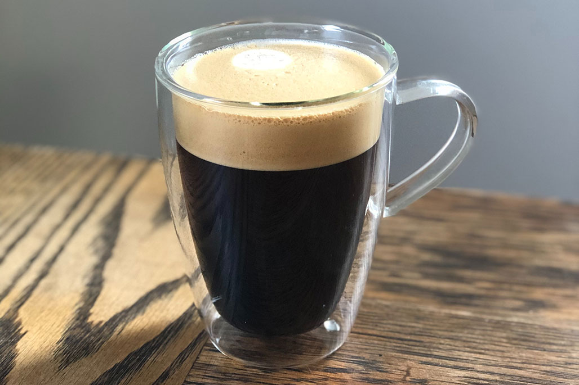
Items sold in the Coffee Department
Americano

Slide 12
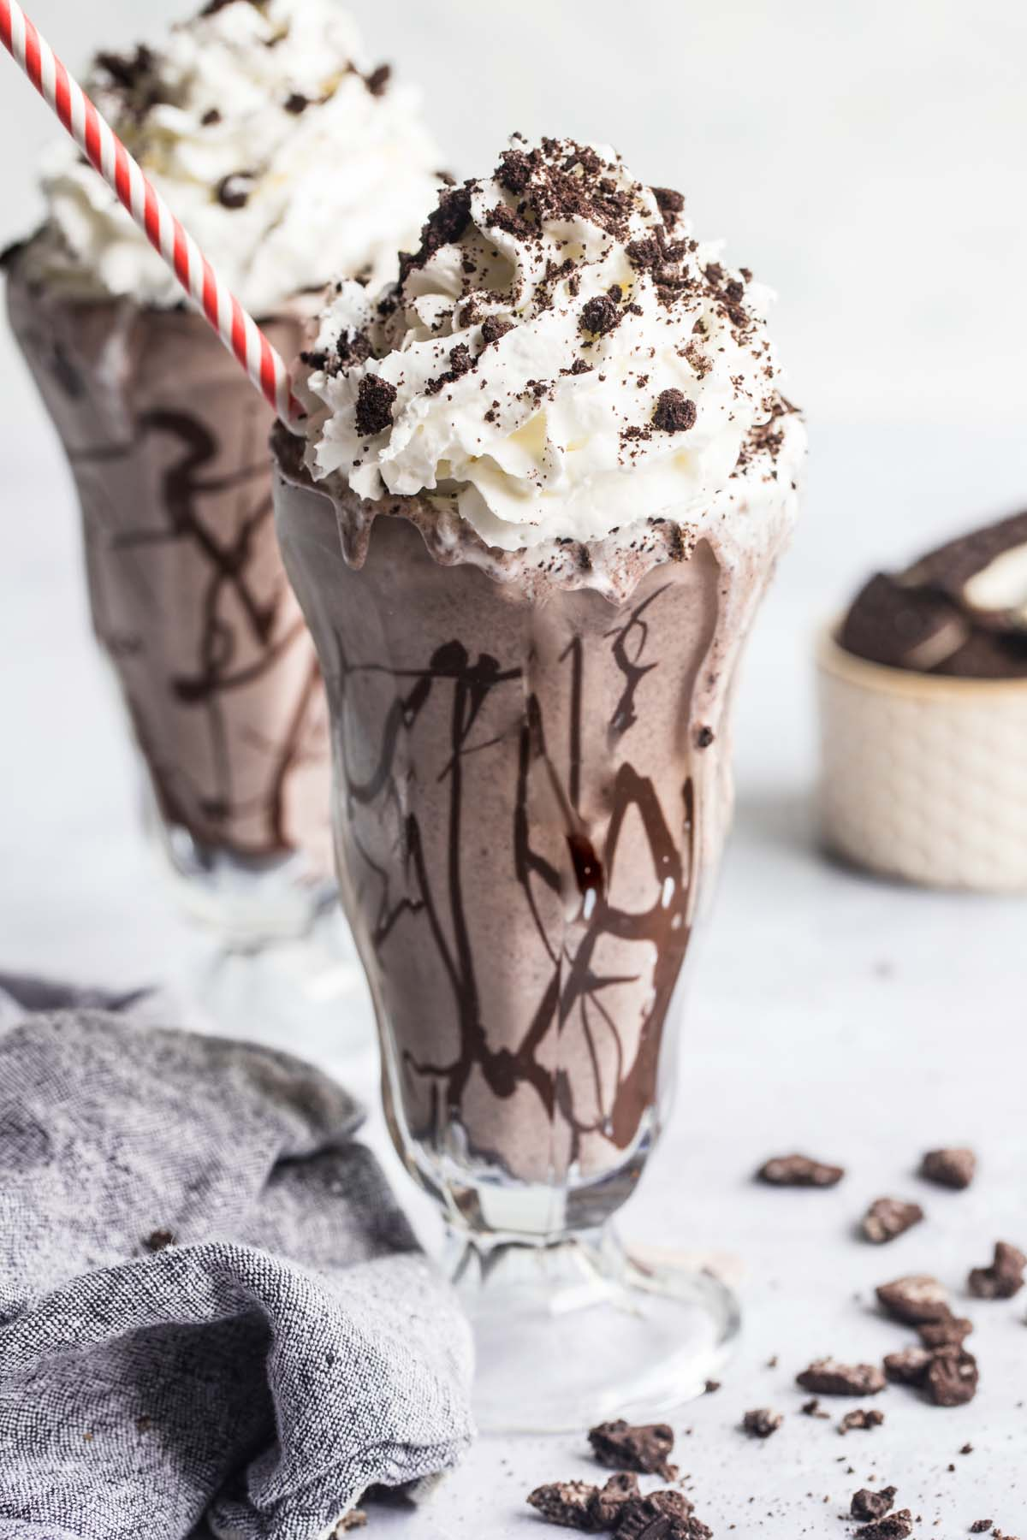
Items sold in the Non-Coffee Department
Oreo Chocolate Milkshake

Slide 13
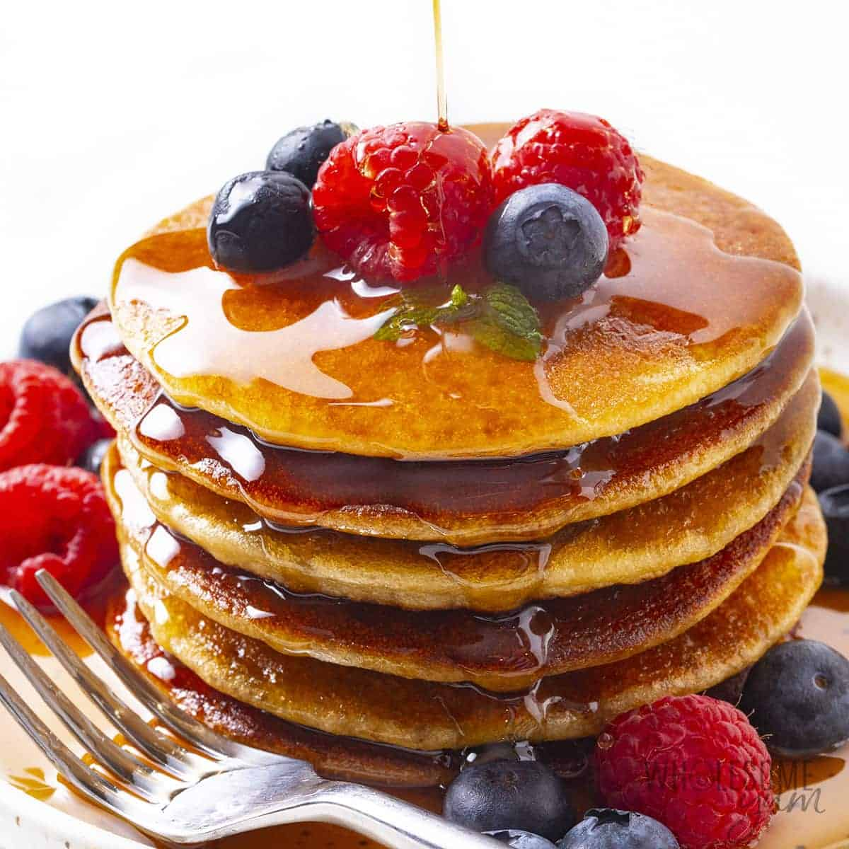
Items sold in the Breakfast Department
Pancakes

Slide 14
Different Marketing Methods
1. Change of Price:
In terms of stimulating market demands, we need to lower the prices to get better deals for customers. At this rate, customers will be thronging the store which will issue us with enough revenue.
2. Desire:
When we talk about desires, we also mean tastes. At this point, we get a range of goods bought and make sure that those goods are available on time. We can also change some recipes to improve the taste so that we can get a lot of buyers for that product.

Slide 15
3. Action:
Improvement in services is what we need to get more customers, so we need more workers and production facilities or machines to get the job done faster and easier.

Slide 16
Employees’ Information
Eric Jones
jones34@coffeetime.com
567 868-0992
Maria Gomez
gom19@coffeetime.com
228 983-9734
Charles Dan
danz@coffeetime.com
224 573-2346
Zaria May
may77@coffeetime.com
263 626-6283
Wendy Lin
lin41@coffeetime.com
228 873-3225
Jade Hans
hans83@coffeetime.com
363 763-8237

Slide 17
References (Pictures)
https://www.istockphoto.com/photos/espresso
https://www.cookingclassy.com/iced-coffee/
https://axilcoffee.com.au/event/latte-art-13/
https://beanbox.com/blog/how-to-make-an-americano
https://dairyfarmersofcanada.ca/en/canadian-goodness/recipes/creating-perfect-cappuccino
https://indianexpress.com/article/lifestyle/food-wine/how-decaffeinated-coffee-made-5362960/
https://www.goodhousekeeping.com/health/diet-nutrition/a38953019/green-tea-weight-loss/
https://www.foodnetwork.com/recipes/bobby-flay/basic-vanilla-milkshake-recipe-1957446
https://meatified.com/bone-broth-smoothies/
https://food.detik.com/info-kuliner/d-3065966/lemon-tea-hingga-es-kelapa-jeruk-minuman-populer-berbahan-jeruk
https://www.verywellhealth.com/black-tea-lowers-mortality-risk-study-6542735
https://www.cookedbyjulie.com/oreo-milkshake/
https://namelymarly.com/vegan-hotdog-buns/
https://www.lifemadedelicious.ca/recipes/grilled-double-cheese-and-bacon-sandwiches/c385dcb4-001c-4b4d-96ea-bd85b52cf00d
https://www.foodandwine.com/desserts/pies/delicious-pies-pi-day
https://www.preciouscore.com/scrambled-eggs-with-vegetables/
https://cookingchew.com/how-to-toast-bread-oven.html
https://www.wholesomeyum.com/keto-almond-flour-pancakes-recipe/
https://www.freeiconspng.com/img/13678
https://www.google.com/url?sa=i&url=https%3A%2F%2Fwww.canva.com%2Fmenus%2Ftemplates%2Fdrink%2F&psig=AOvVaw3C56oZLlO96QU25JW1zVKX&ust=1674448337994000&source=images&cd=vfe&ved=0CBAQjRxqFwoTCLjnsKWs2vwCFQAAAAAdAAAAABAE

